Slide 1

CookBook Pro
Group Members:
Nicholas Cangialosi • Dino Angelovski • Haris Mulic • Matt Polanco
Notes:
CookBook Pro is our group’s final web project. The purpose of this website is to help users discover recipes and automatically manage ingredients through a personalized system.

Slide 2

Website Purpose
Centralized recipe discovery platform
Automatically manage ingredients
User-specific saved data
Notes:
The goal of CookBook Pro is to simplify cooking by combining recipes with an ingredient management system tied directly to the user.

Slide 3
Technologies Used
HTML & CSS
JavaScript
PHP
MySQL (phpMyAdmin)
Notes:
HTML and CSS handle what you see and the styling. JavaScript handles the logic. PHP manages server-side logic and sessions, MySQl handles users and the saved recipes

Slide 4
Website Architecture
Login / Register Page
Homepage (Recipe Listing)
Recipe Detail View
Database Backend
Ingredient List Page
Git / Github usage
Notes:
Pages interact through PHP sessions and database queries. User actions update the database, and results are applied.

Slide 5
Working Features
User login and registration
Recipe browsing
Ingredients List tied to user account
Persistent data storage
Notes:
These core features are functional and persist across sessions. User-specific ingredient data is stored in the database.

Slide 6
Key Screenshots
Login and Registration screen
Recipe browsing page
Ingredients List view
Notes:
During the presentation, we will show screenshots or a live demo of these core pages.

Slide 7
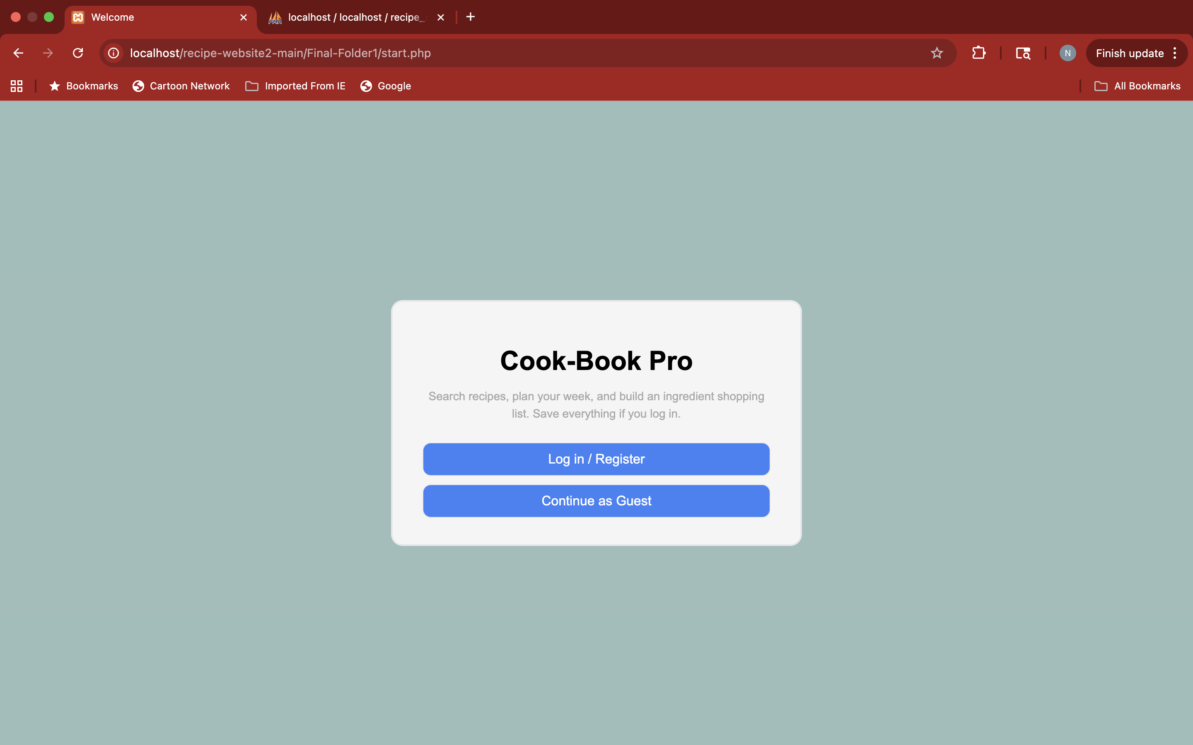
Login / Registration Page

Slide 8
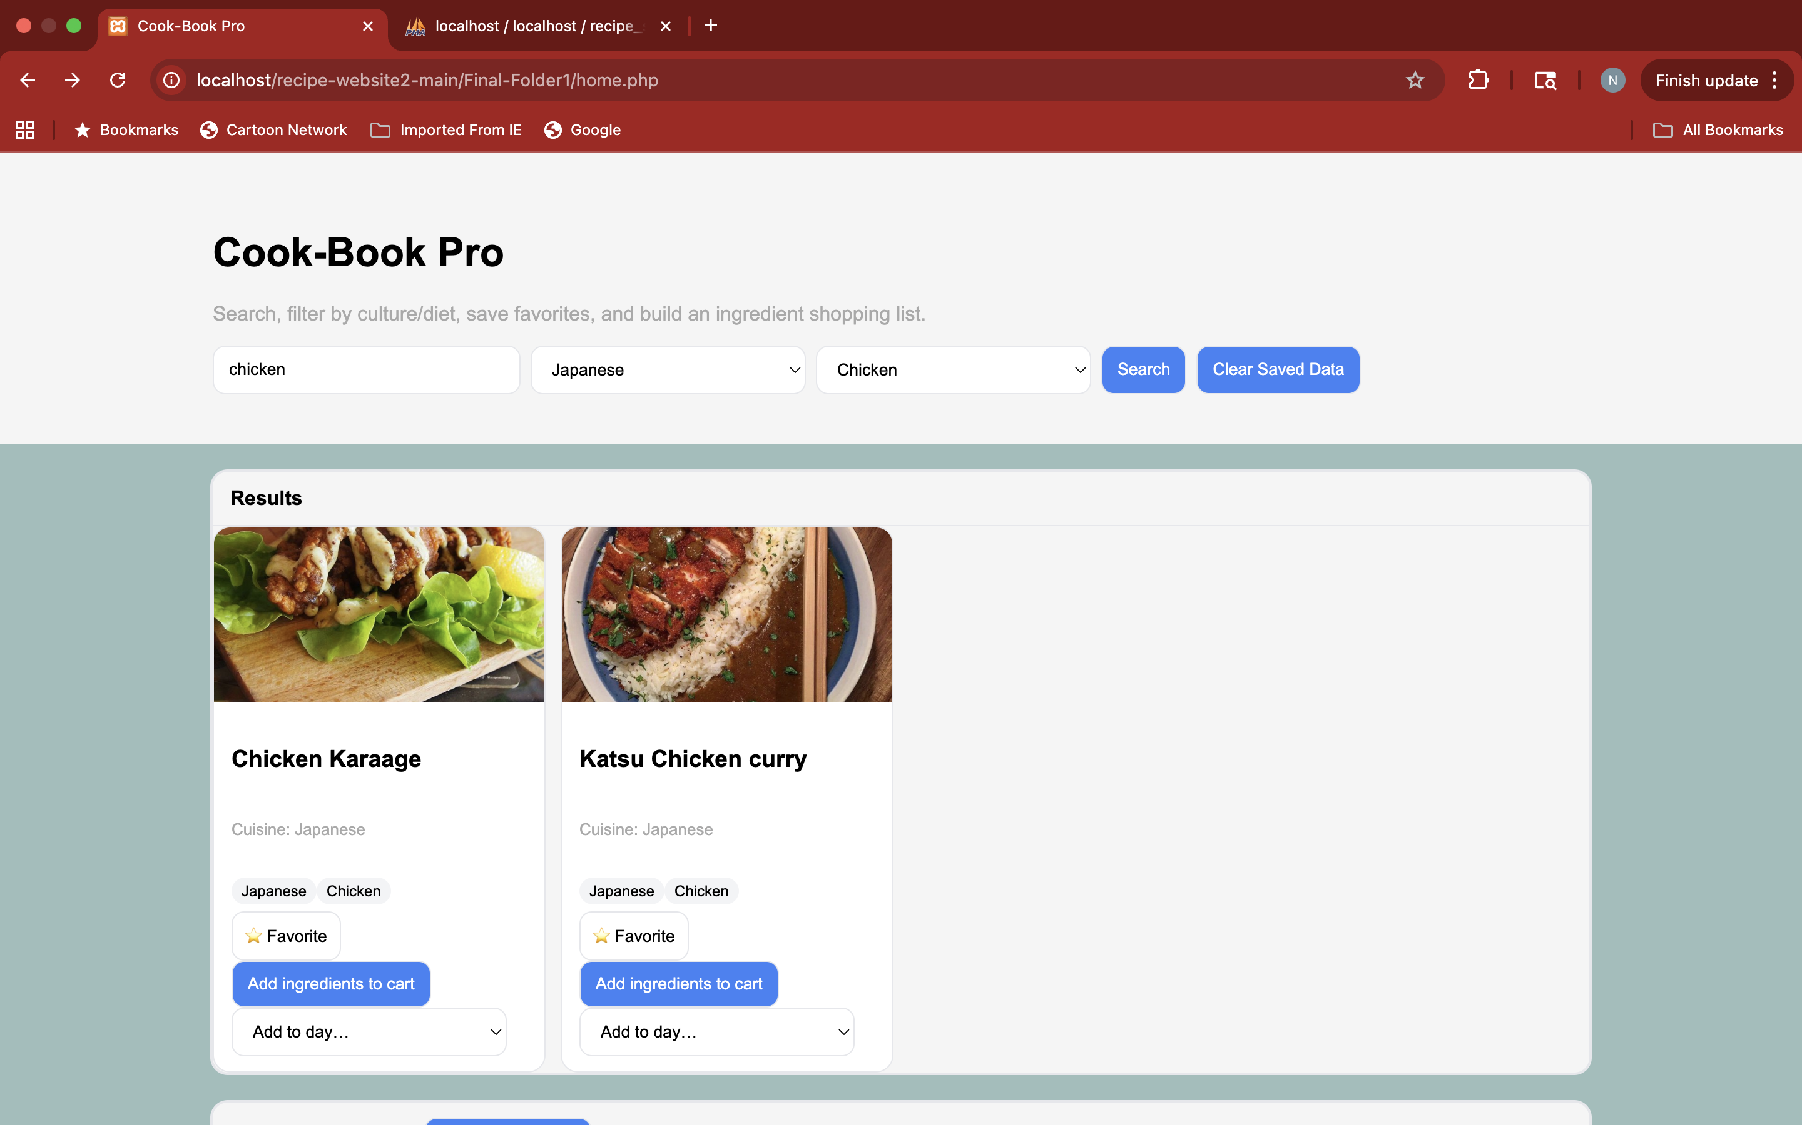
Home Page

Slide 9
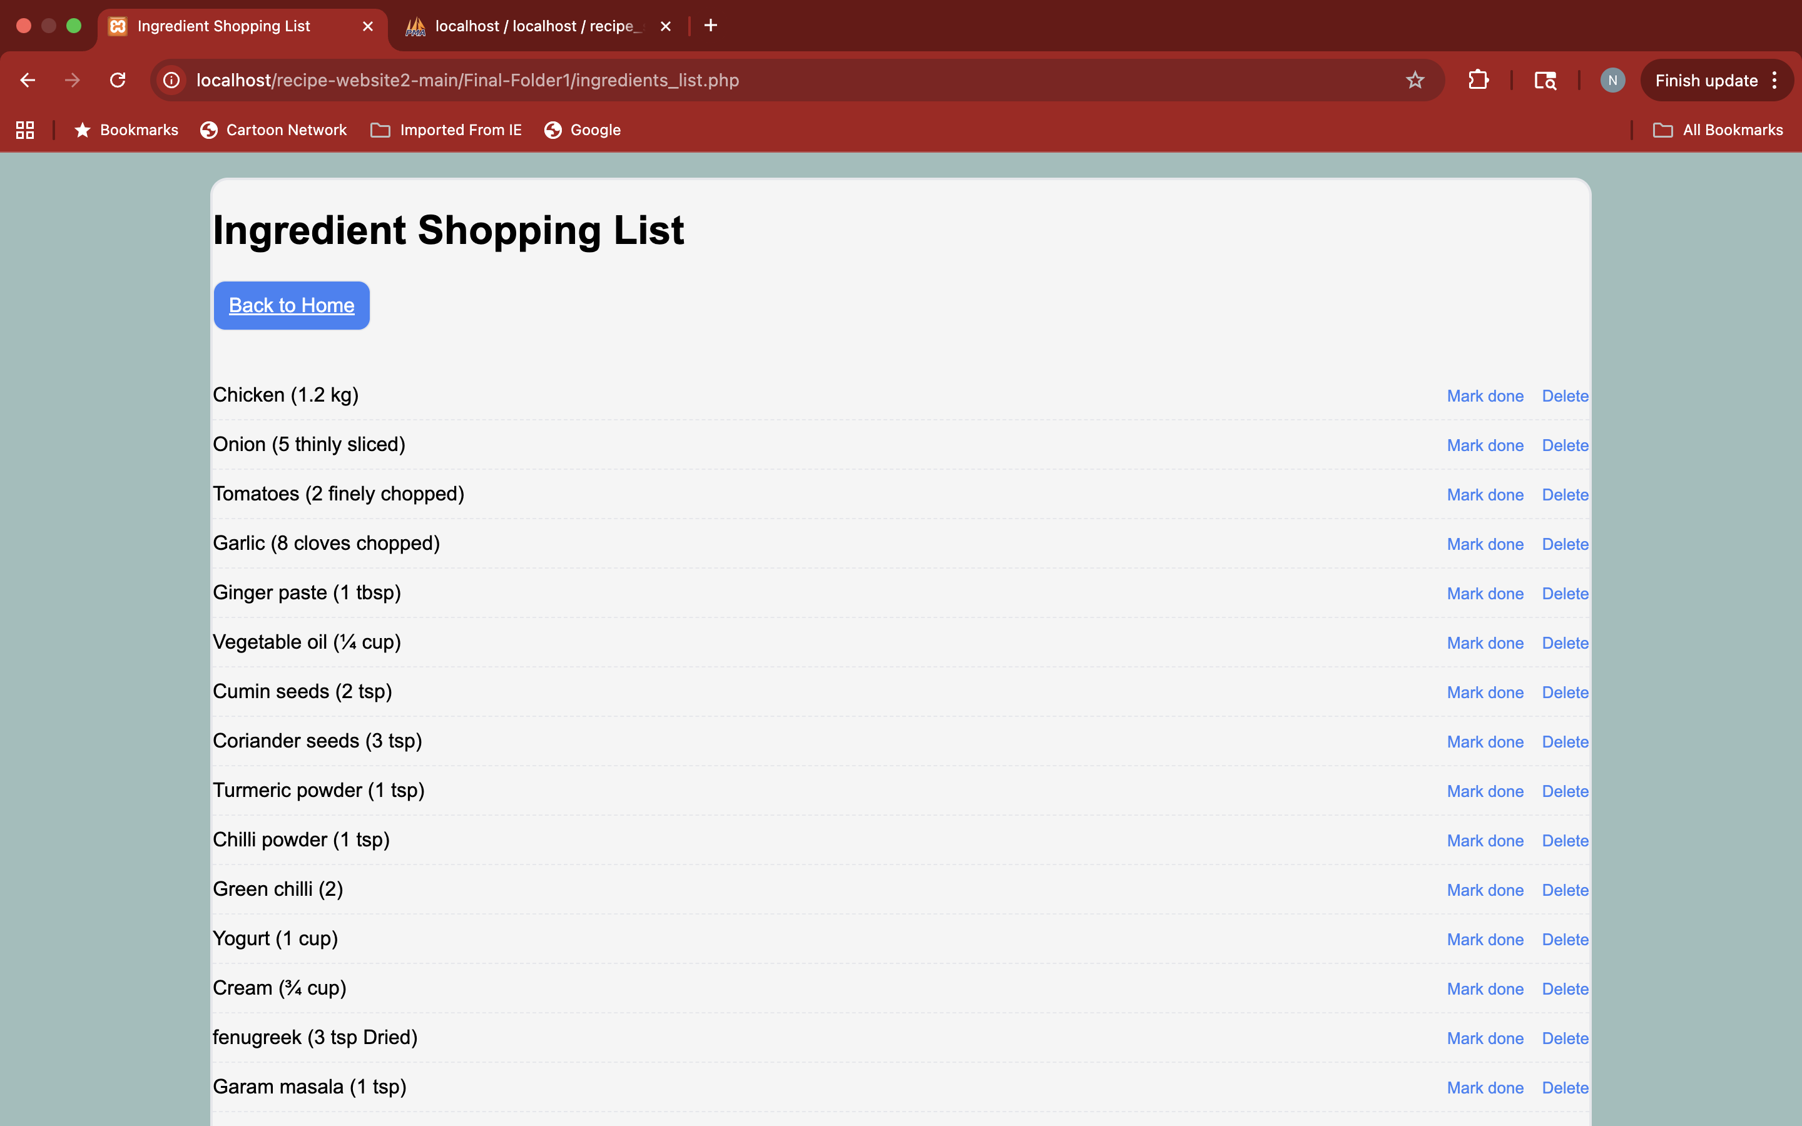
Ingredients List

Slide 10
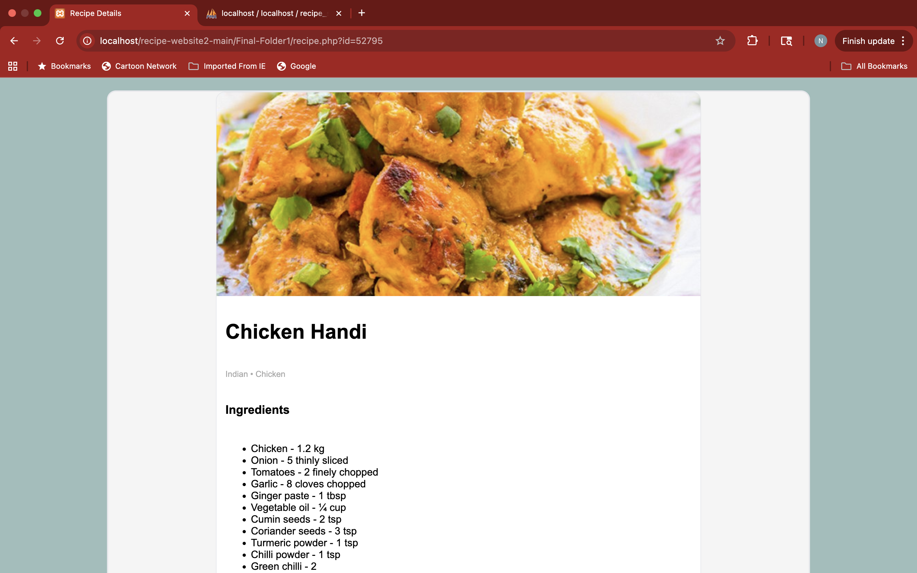
Recipe Information

Slide 11
Partially Working / Unfinished Features
Advanced recipe filtering
Favorites optimization
UI polish on all pages
Notes:
Some features were started but not fully completed due to time constraints. Example would be the UI.

Slide 12
Future Improvements
Meal planning tools
Mobile-friendly UI
Performance optimization
Notes:
With more time, the website could be expanded to include advanced personalization and mobile support.

Slide 13
Project Status
Website is fully functional at core level
Some features are partially implemented
Notes:
The core functionality works as expected. Any partially completed features are clearly documented.

Slide 14
Thank you!
Notes:
Overall, CookBook Pro successfully shows web application built with modern web technologies.

